Slide 1



Robotic Arm BCI
309
8 Credits
Saisri
‹#›
6/05/2021
Robotic Arm BCI

Slide 2


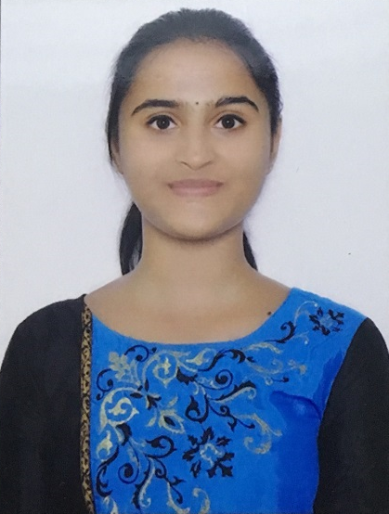
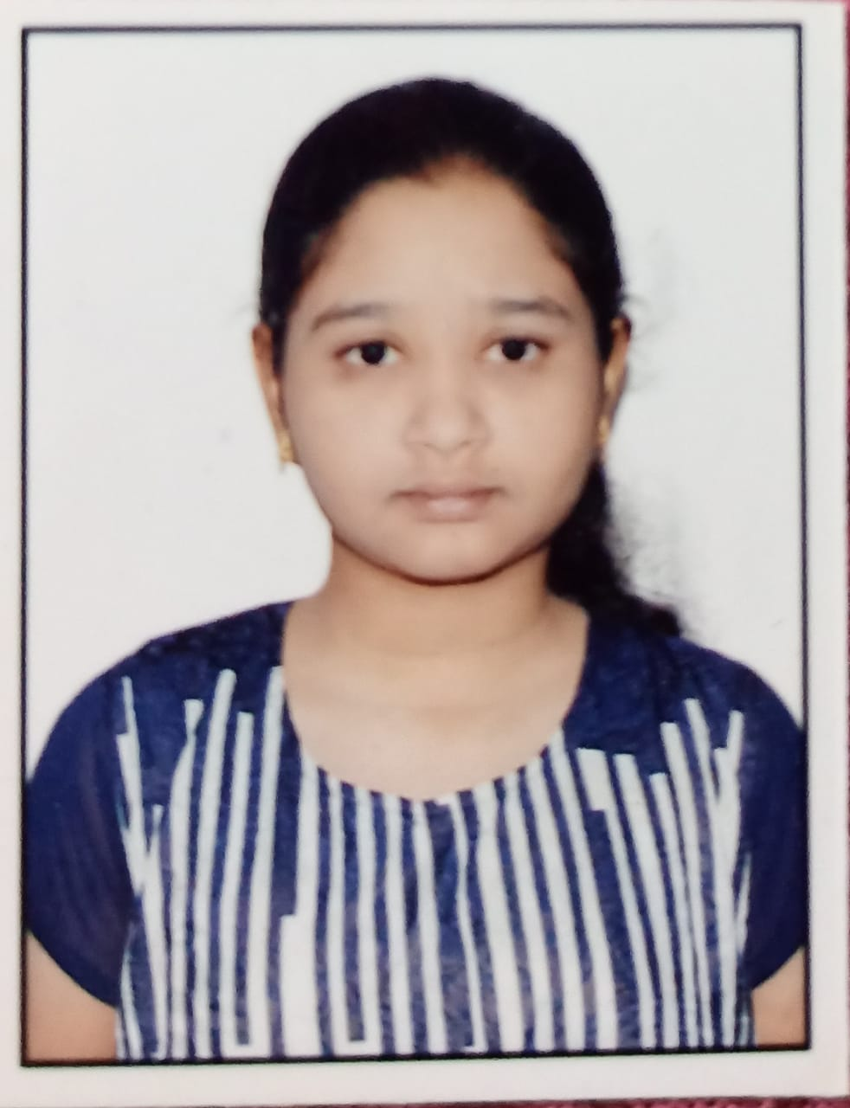
TEAM COMPOSITION
SL. NO | Name of the student | SRN | PHOTO
1 | Harshita R Vastrad | PES1201701717
2 | Shreya V Deexit | PES1201701648
3 | V Saisri | PES1201701763
Saisri
Guide : Dr. B. Niranjana Krupa
Prof. Swetha G
‹#›
6/05/2021
Robotic Arm BCI

Slide 3
PROBLEM STATEMENT
To use Brain computer interface(BCI) to interact between robot and human, without participation of human hand and assist the patient impaired by neurological conditions
The robotic arm will be able to pick up lightweight objects like medicines, water bottle etc. from one place as interpreted from the brain waves of the user and drop it to a predefined location
Saisri
‹#›
6/05/2021
Robotic Arm BCI

Slide 4

Motivation
The Brain Signals of such patients can be used to help them communicate to others and also to perform various tasks by providing necessary infrastructure and training.
BCI system processes the electrical activity of the brain and generates the commands.
Hence external devices can be controlled using these commands.
Saisri
‹#›
6/05/2021
Robotic Arm BCI

Slide 5

OBJECTIVE
To use brain waves to control robotic arm movement:
Pre-processing the dataset,
classifying and sending the classified signal output to robot for arm movement.
Image processing for recognition of objects to pick and drop:
This process involves object detection.
The robot will be able to
detect objects,
pick and drop the detected object.
The outcome of this process is movement of the robotic arm without any motion or gesture in the patients.
Saisri
‹#›
6/05/2021
Robotic Arm BCI

Slide 6
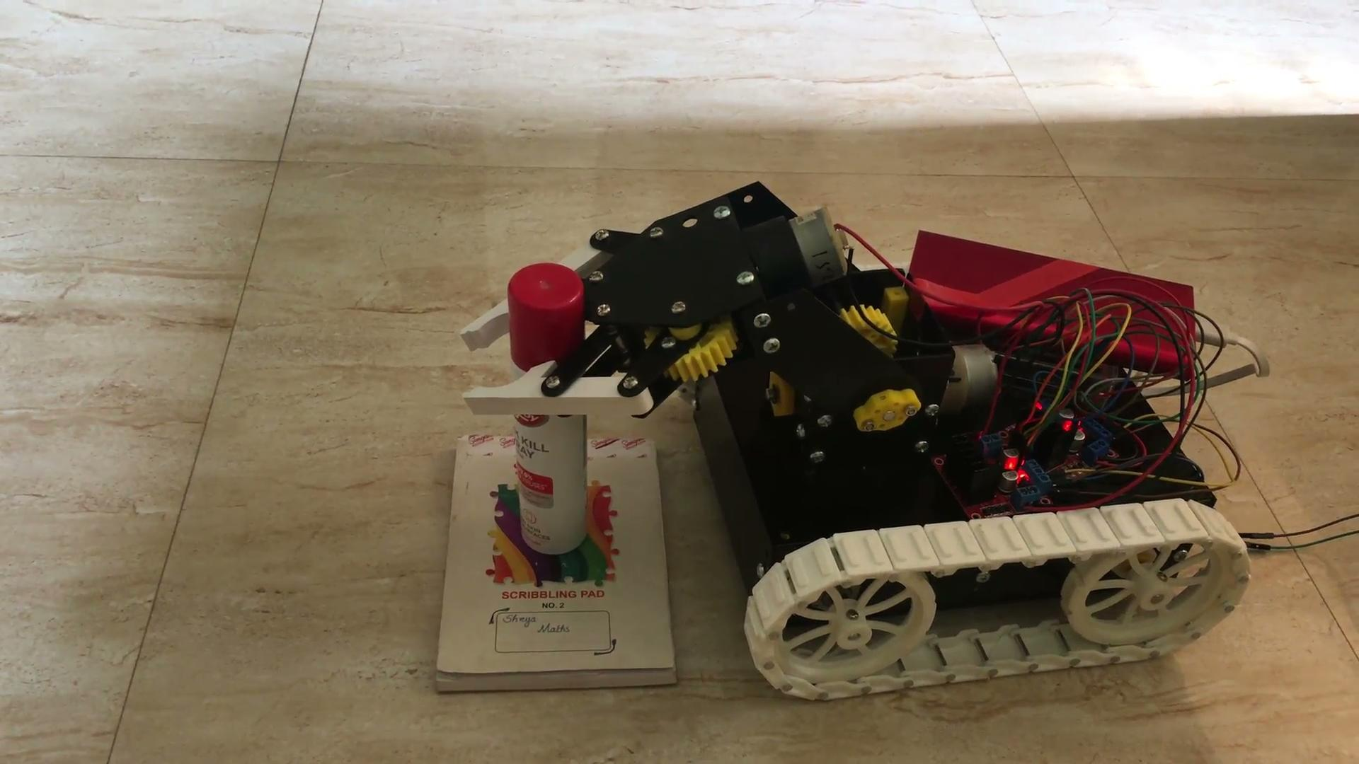

Saisri
‹#›
6/05/2021
Robotic Arm BCI

Slide 7

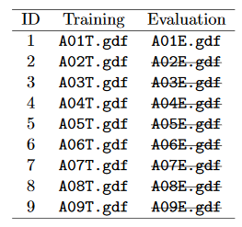
DATASET
BCI Competition 2008 – Graz data set A :
9 participants . 4 classes. Left hand,Right hand, Feet, Tongue.
22 EEG signals, 3 EOG signals(for eye movements)
Signals were sampled at 250Hz, and bandpass 0.5Hz and 100Hz,The sensitivity of the amplifier was set to 100μV. An additional 50 Hz notch filter was enabled to suppress line noise.
Files are in .gdf format
Files in the dataset:
Saisri
‹#›
6/05/2021
Robotic Arm BCI

Slide 8

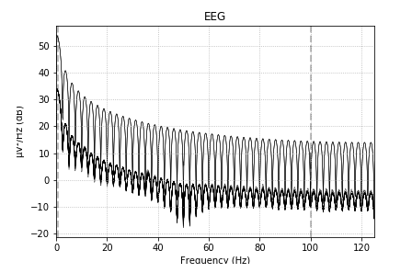
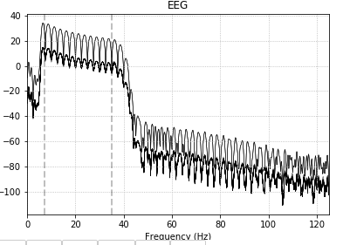
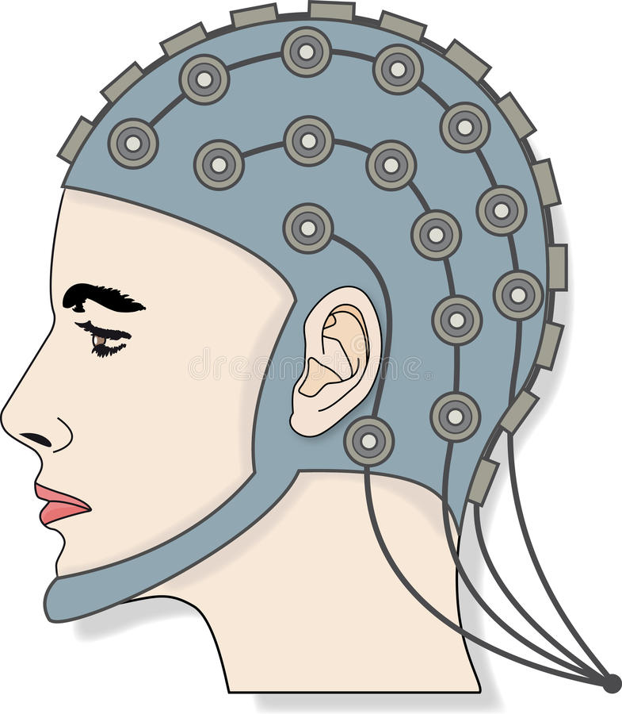
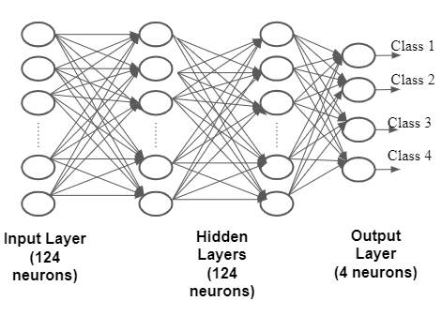
Block Diagram
Bandpass filter
Select 22 channels
Rename channels
Wavelet Packet Decomposition
25 channels
FIR filter parameters:
Hamming window
Lower passband edge: 7.00
Upper passband edge: 35.00 Hz
Order :4
bads: 3 items (EOG-left, EOG-central, EOG-right)
288, 22, 751
288, 22, 751
8, 288, 22, 30
Train test split
80:20
Test: 58,32
Train: 230,32
Raspberry Pi
camera
Robotic Arm
Raspberry Pi
Harshita
‹#›
‹#›
6/05/2021
Robotic Arm BCI

Slide 9
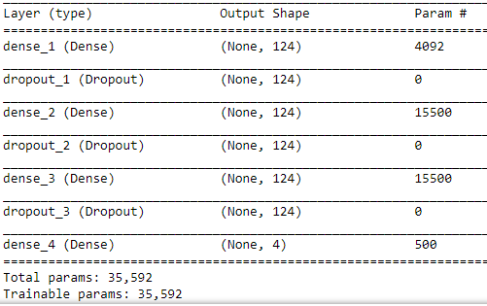
ANN MODEL
Class 1
Class 2
Class 3
Class 4
Input Layer
(124 neurons)
Hidden Layers
(124 neurons)
Output Layer
(4 neurons)
Harshita
‹#›
6/05/2021
Robotic Arm BCI

Slide 10
ACCURACY
Fine tuning the model by varying different parameters
Parameters | Accuracy
Changing the optimizer (adam) | 68.27%
Changing drop out value(0.2) | 67.06%
Number of layers | 68.79% (Two hidden layers) 67.23% (Single hidden layer)
Early stopping | 70.6%
L2 Regularisation | 69.65%
Harshita
‹#›
6/05/2021
Robotic Arm BCI

Slide 11
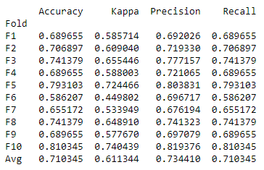
RESULT
After trying many variations in the model, this is the best accuracy we have got
Dropout : 0.5
L2 regularizer
Optimizer : Rmsprop
2 Hidden Layers
loss = Categorical crossentropy
Harshita
‹#›
6/05/2021
Robotic Arm BCI

Slide 12
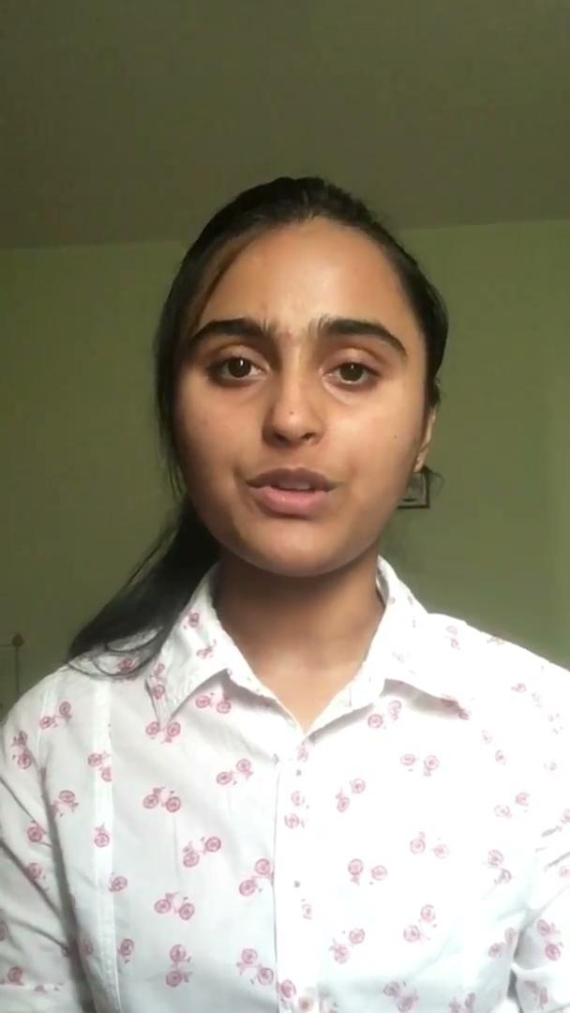
CONSTRAINTS
Colored objects are considered to be Lightweight objects
Input given to robotic arm and object color that has to be picked
Class 1 - Left - Orange
Class 2 - Right - Red
Class 3 - Front - Blue
Class 4 - Back - Green
Based on the input Robotic arm rotates and moves in that direction,
detecting the colored object and avoiding
Shreya
‹#›
6/05/2021
Robotic Arm BCI

Slide 13
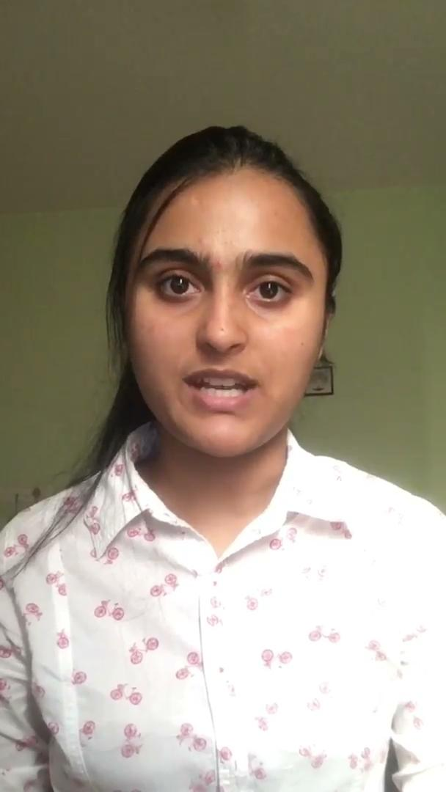
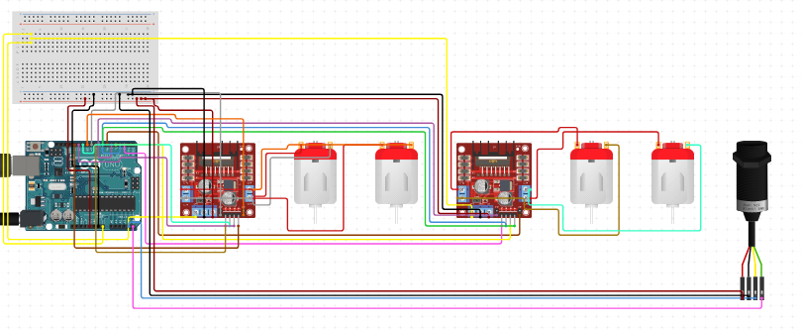
CIRCUIT DIAGRAM
Camera
Raspberry Pi
DC motors for controlling wheels
DC motors for controlling Robotic Arm
Shreya
‹#›
6/05/2021
Robotic Arm BCI

Slide 14
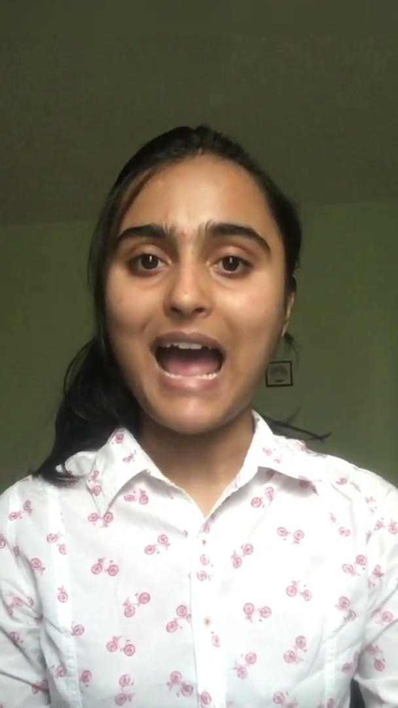
WORKFLOW
Get image frames from video
Convert BGR color space to HSV color space
Define the range and create mask
Capture video through pi camera
Create contour to track color
Bitwise and between image frame and mask
Dilation
Color detection
Shreya
‹#›
6/05/2021
Robotic Arm BCI

Slide 15
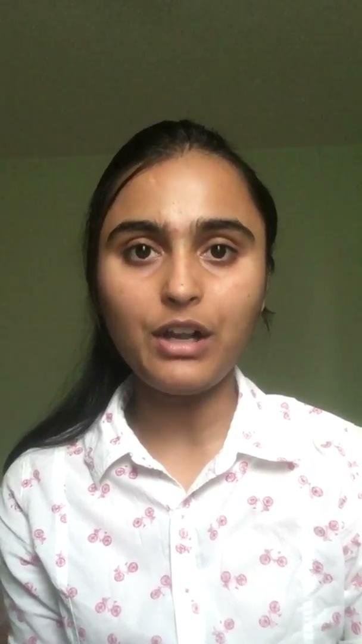
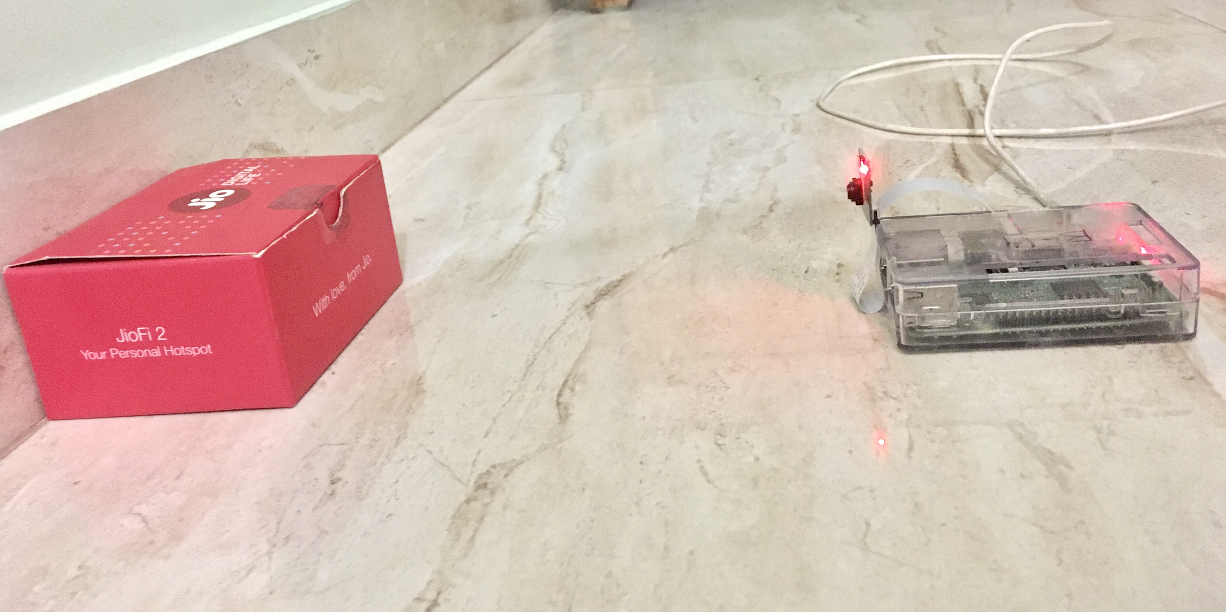
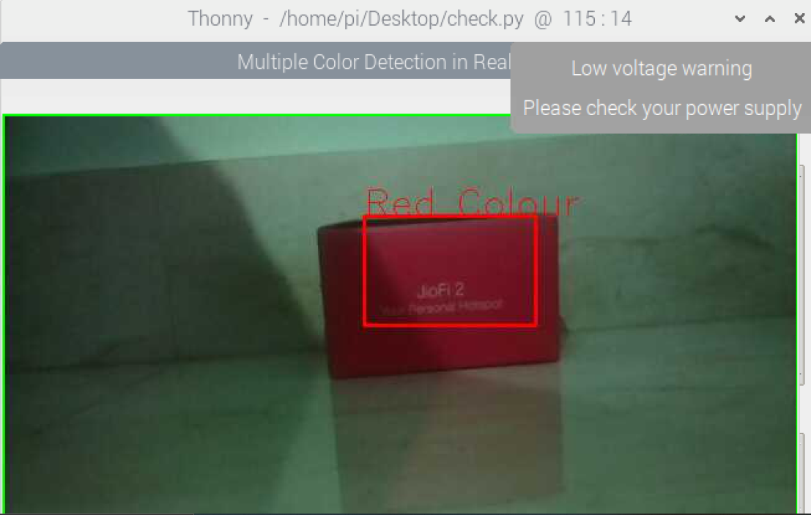
OBJECT COLOR DETECTION
Setup for colour detection
Image showing the output of detected red coloured object
Assumption
Objects - colored boxes
Shreya
‹#›
6/05/2021
Robotic Arm BCI

Slide 16
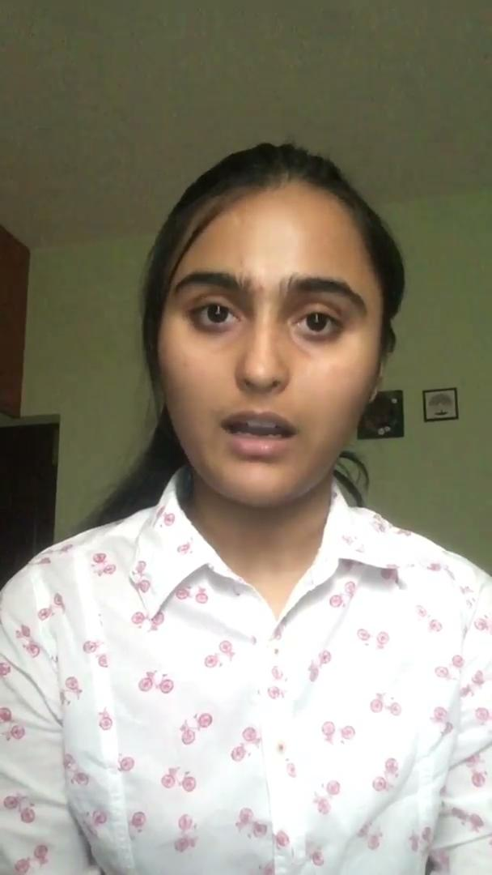

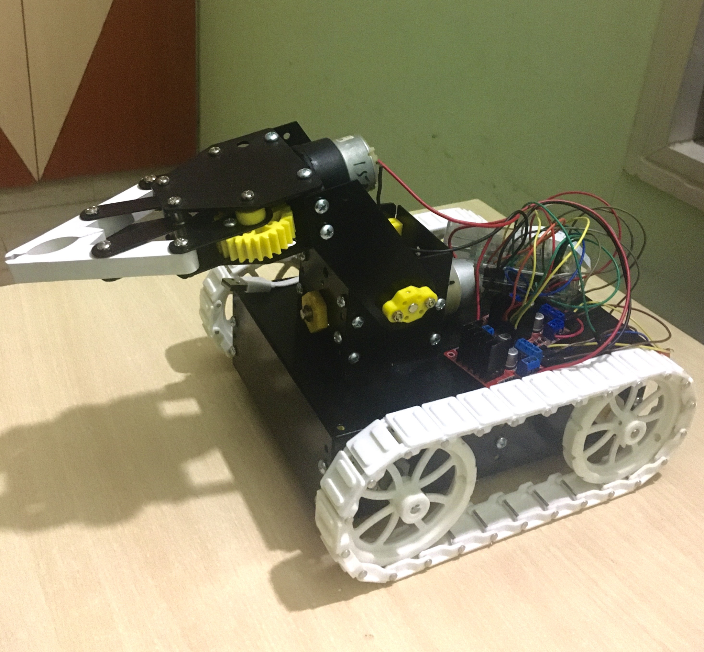




MOTOR MOVEMENTS
Robotic Arm
Path followed by robotic arm
‹#›
6/05/2021
Robotic Arm BCI

Slide 17

THANK YOU...
17/03/2021
Robotic Arm BCI
‹#›

